Slide 1
Assessing Concordance among Diagnostic Tests for Malaria using Latent Class Analysis
Noory Kim
BIOS 841
April 2013

Slide 2
Issue: There is no gold standard diagnostic test for malaria.
Method | Sensitivity | Specificity | Time | Cost
Microscopy | Low when parasite densities are low | Low to Medium | Short to Long: need to have microscope on-site or ship to lab | Expensive: laborious
PCR | Low to High: depends on parasite densities | Low to High | Long: need to ship sample to lab | Expensive: laborious
Rapid diagnostic tests | ? | ? | Short: on-site | Less expensive
Notes:
Ref:
http://www.ncbi.nlm.nih.gov/pubmed/20595479
Am J Trop Med Hyg. 2010 Jul;83(1):61-8. doi: 10.4269/ajtmh.2010.09-0632.
Cost savings with rapid diagnostic tests for malaria in low-transmission areas: evidence from Dar es Salaam, Tanzania.
Yukich J, D'Acremont V, Kahama J, Swai N, Lengeler C.
http://www.malariajournal.com/content/pdf/1475-2875-5-121.pdf
Comparison of PCR and microscopy for the detection of asymptomatic malaria in a Plasmodium falciparum/vivax Endemic area in Thailand
Russell E Coleman et al.
Malaria Journal 2006, 5:121 doi:10.1186/1475-2875-5-12

Slide 3
Methodologies for assessing concordance
 | Agreement Indices (e.g. kappa statistic) | Latent class analysis
Assesses degree of rater concordance/ discordance | ✔ | ✔
Differentiates between sensitivity and specificity | No | ✔
Consistent over changes in prevalence rates | No | ?
Notes:
http://www.malariajournal.com/content/pdf/1475-2875-5-121.pdf
Comparison of PCR and microscopy for the detection of asymptomatic malaria in a Plasmodium falciparum/vivax Endemic area in Thailand
Russell E Coleman et al.
Malaria Journal 2006, 5:121 doi:10.1186/1475-2875-5-12

Slide 4
Latent class analysis
Assumes each individual in a study population belongs to one of several “latent classes”
Memberships are not directly observable. Ex. malarial disease status.
Memberships are inferred from a combination of observed categorical “manifest variables”. Ex. survey responses; different malarial diagnostic tests.
Typical Goals
Quantitative: Determine the lowest number of latent classes that are distinct from each other.
Qualitative: See and describe how the classes differ from each other. (“latent class separation”)
Assumptions
Conditional independence: Within each latent class, the manifest variables are assumed to be independent.
Realistic?

Slide 5
Models Considered
Goal: To assess degree of concordance between three types of diagnostic tests for malaria
Models considered
Originally in the Statistical Analysis Plan (SAP)
Basic latent class model (with no covariates)
Latent class model with covariates
Age
Gravidity
Not in the SAP
Latent class model with covariates treated as manifest variables
Software used: R package poLCA (Linzer and Lewis, 2011)

Slide 6
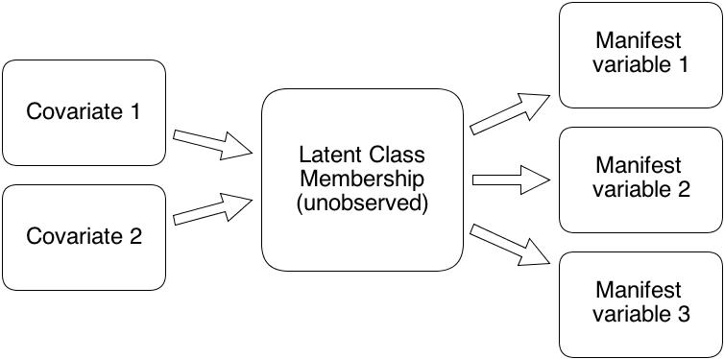
Basic LCA Model

Slide 7
LCA Model with Covariates

Slide 8
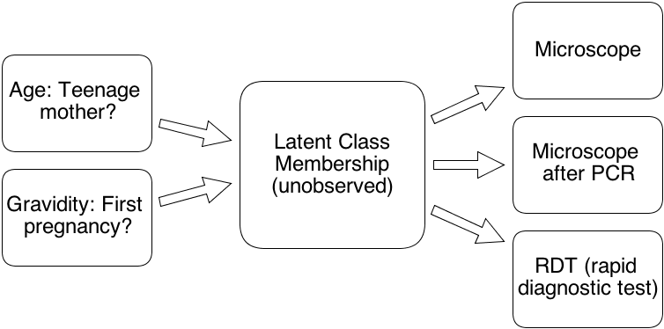
Basic LCA Model

Slide 9
LCA Model with Covariates
Not a identifiable model, since the number of parameters to be estimated exceeds the degrees of freedom (which equals the number of cells in the contingency table minus 1).

Slide 10
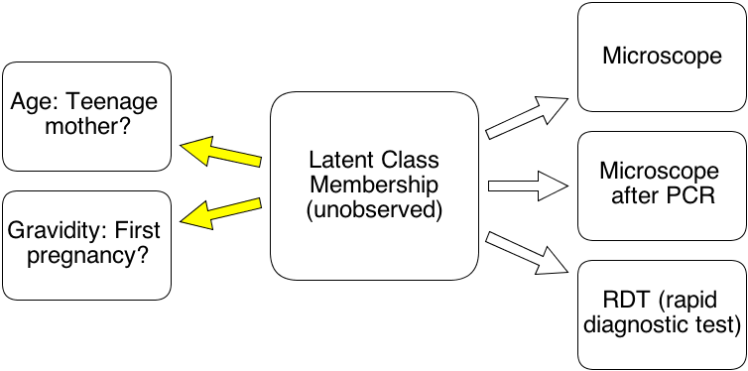
Treating Covariates as Manifest Variables
The model is now identifiable, but the interpretability of the covariates has changed.

Slide 11
Data Cleaning & Preparation
> 5740 records in 4 data tables; merged tables by participant ID number
Data cleaning
Dichotomize diagnostic test results, time, and covariates.
Test: 1 if any malaria detected; 0 otherwise (except missing values)
Time of test: (NumberVisit=‘mEli’) → (trimester=2); o.w. (trimester=3)
Age: (ScrMotherAge<20) → (teen=1); o.w. (teen=0)
Gravidity: (ScrMotherChild=0) → (firstpreg=1); o.w. (firstpreg=0)
Remove records that are duplicates (by id, trimester, and test result).
Set as missing any conflicting results for the same test in records having the same id and same trimester.
Combine results for same test from different trimesters using a “once positive, always positive” assumption
Since no complete cure malaria exists, and
Since not all samples from a person with malaria necessarily have malarial parasites.
This was a workaround to the relatively small presence of longitudinal data.
Final working data set
Observations for 1308 unique participants
608 had complete data (at least one result from each test & no missing covariates).

Slide 12
Response Patterns of Positive Diagnosis with (Microscopy, PCR, RDT)
Response | Count |  | Response | Count
(1,1,1) | 41 |  | (1,m,1) | 66
(1,1,0) | 22 |  | (1,m,0) | 21
(1,0,1) | 11 |  | (0,m,1) | 153
(0,1,1) | 78 |  | (0,m,0) | 312
(1,0,0) | 23 |  | (m,1,1) | 5
(0,1,0) | 80 |  | (m,1,0) | 3
(0,0,1) | 74 |  | (m,0,1) | 4
(0,0,0) | 280 |  | (m,0,0) | 6
(1,1,m) | 0 |  | (1,m,m) | 1
(1,0,m) | 0 |  | (0,m,m) | 1
(0,1,m) | 1 |  | (m,m,1) | 47
(0,0,m) | 1 |  | (m,m,0) | 80
The following responses were not observed: (1,1,m), (1,0,m), (m,1,m), (m,0,m)

Slide 13
Comparing Basic LCA models (no covariates)
# classes | # cells | df** | Model parameters to be estimated | Residual df*** | AIC* | BIC* | G² (LRT statistic)
1 | 8 | 7 | 3 | 4 | 3568.4 | 3584.0 | 112.4
2 | 8 | 7 | 7 | 0 | 3416.1 | 3452.3 | 5.45
* Lower is better
** # degrees of freedom =
# cells in contingency table - 1
*** Residual degrees must be nonnegative in order for the model to be identifiable

Slide 14
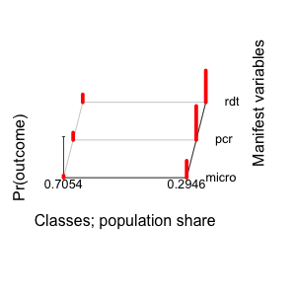
Basic LCA model with 2 classes: Probabilities of positive diagnosis
Diagnostic method | Latent class 1: Lower prevalence rates | Latent class 2: Higher prevalence rates
Microscopy | 0.05 | 0.41
PCR | 0.18 | 0.83
RDT | 0.19 | 0.78

Slide 15
Basic LCA model with 2 classes: Probabilities of positive diagnosis
Diagnostic method | Latent class 1: Lower rates of (+) diagnoses | Latent class 2: Higher rates of (+) diagnoses
Microscopy | 0.05 | 0.41
PCR | 0.18 | 0.83
RDT | 0.19 | 0.78

Slide 16
Comparing LCA models with the covariate firstpreg
# classes | # cells | df | Model parameters to be estimated | Residual df | AIC | BIC | Negative max log-likelihood
1 | 8 | 7 | 3 * | 4 | 3562.8 | 3578.3 | 112.2
2 | 8 | 7 | 8 | -1 **
* The LCA model with one class is not affected by the addition of covariates. (The slight differences from the previous one-class model in the goodness-of-fit measures are due to the discarding of a few observations missing a value for firstpreg.)
** The model requires the estimation of an additional parameter (the effect size of the covariate on the latent variable). This makes non-identifiable any model with more than one latent class.

Slide 17
Comparing LCA models treating firstpreg and teen as manifest vars.
# classes | # cells | df | Model parameters to be estimated | Residual df | AIC | BIC | Negative max log-likelihood
1 | 32 | 31 | 5 | 28 | 6236.6 | 6262.5 | 322.7
2 | 32 | 31 | 11 | 20 | 5753.4 | 5810.4 | 90.9
3 | 32 | 31 | 17 | 14 | 5677.7 | 5765.7 | 33.3
4 | 32 | 31 | 23 | 8 | 5670.0 | 5789.2 | 16.5
5* | 32 | 31 | 29 | 2 | 5678.4 | 5828.5 | 14.7
* The MLE for the 5 class model was not found by the software poLCA.

Slide 18
Comparing LCA models treating firstpreg and teen as manifest vars.
The MLE for the 5 class model was not found by the software poLCA.

Slide 19
Comparing LCA models treating firstpreg and teen as manifest vars.
Choose a 3-class model, as it has the lowest BIC and as the AIC values flatline after the number of classes exceeds 3.
The MLE for the 5 class model was not found by the software poLCA.

Slide 20
3-class LCA model with 2 manifest covariates
Manifest variable | Latent class 1: First pregnancies | Latent class 2: Highest prevalences | Latent class 3: Teenage mothers
Microscopy | 0.06 | 0.46 | 0.25
PCR | 0.17 | 0.88 | 0.67
RDT | 0.20 | 0.80 | 0.59
firstpreg | 0.96 | 0.82 | 0.17
teen | 0.08 | 0.20 | 1.00

Slide 21
3-class LCA model with 2 manifest covariates
Manifest variable | Latent class 1: First pregnancies | Latent class 2: Highest rate of (+) diagnoses | Latent class 3: Teenage mothers
Microscopy | 0.06 | 0.46 | 0.25
PCR | 0.17 | 0.88 | 0.67
RDT | 0.20 | 0.80 | 0.59
firstpreg | 0.96 | 0.82 | 0.17
teen | 0.08 | 0.20 | 1.00

Slide 22
Summary
Basic LCA models
PCR and RDT methods have concordance within 5% of each other, even when probabilities of positive diagnosis are below 20%.
Weak concordance between microscopy and the other two methods.
LCA models with covariates are non-identifiable
LCA models treating covariates as manifest
Concordance between PCR and RDT within 8%.
This model provides weak, if any, evidence for causal inference.
Suggestions for future work
Setting parameter restrictions to ensure identifiability of models with covariates.
Treating covariates as continuous
Treating manifest variables as continuous → Latent trait analysis
Include an indicator for household income as a covariate
Teenage mother with multiple children ←→ Poverty

Slide 23
References and Acknowledgements
Thanks to Dr. Steven Meshnick and Dr. Steve Taylor for the opportunity to work on the project data set.
Some references:
Collins LM and Lanza ST. (2010) Latent Class and Latent Transition Analysis. Wiley.
Linzer, DA and Lewis J. (2011) "poLCA: an R Package for Polytomous Variable Latent Class Analysis." Journal of Statistical Software. 42(10): 1-29. http://www.jstatsoft.org/v42/i10

